Slide 1
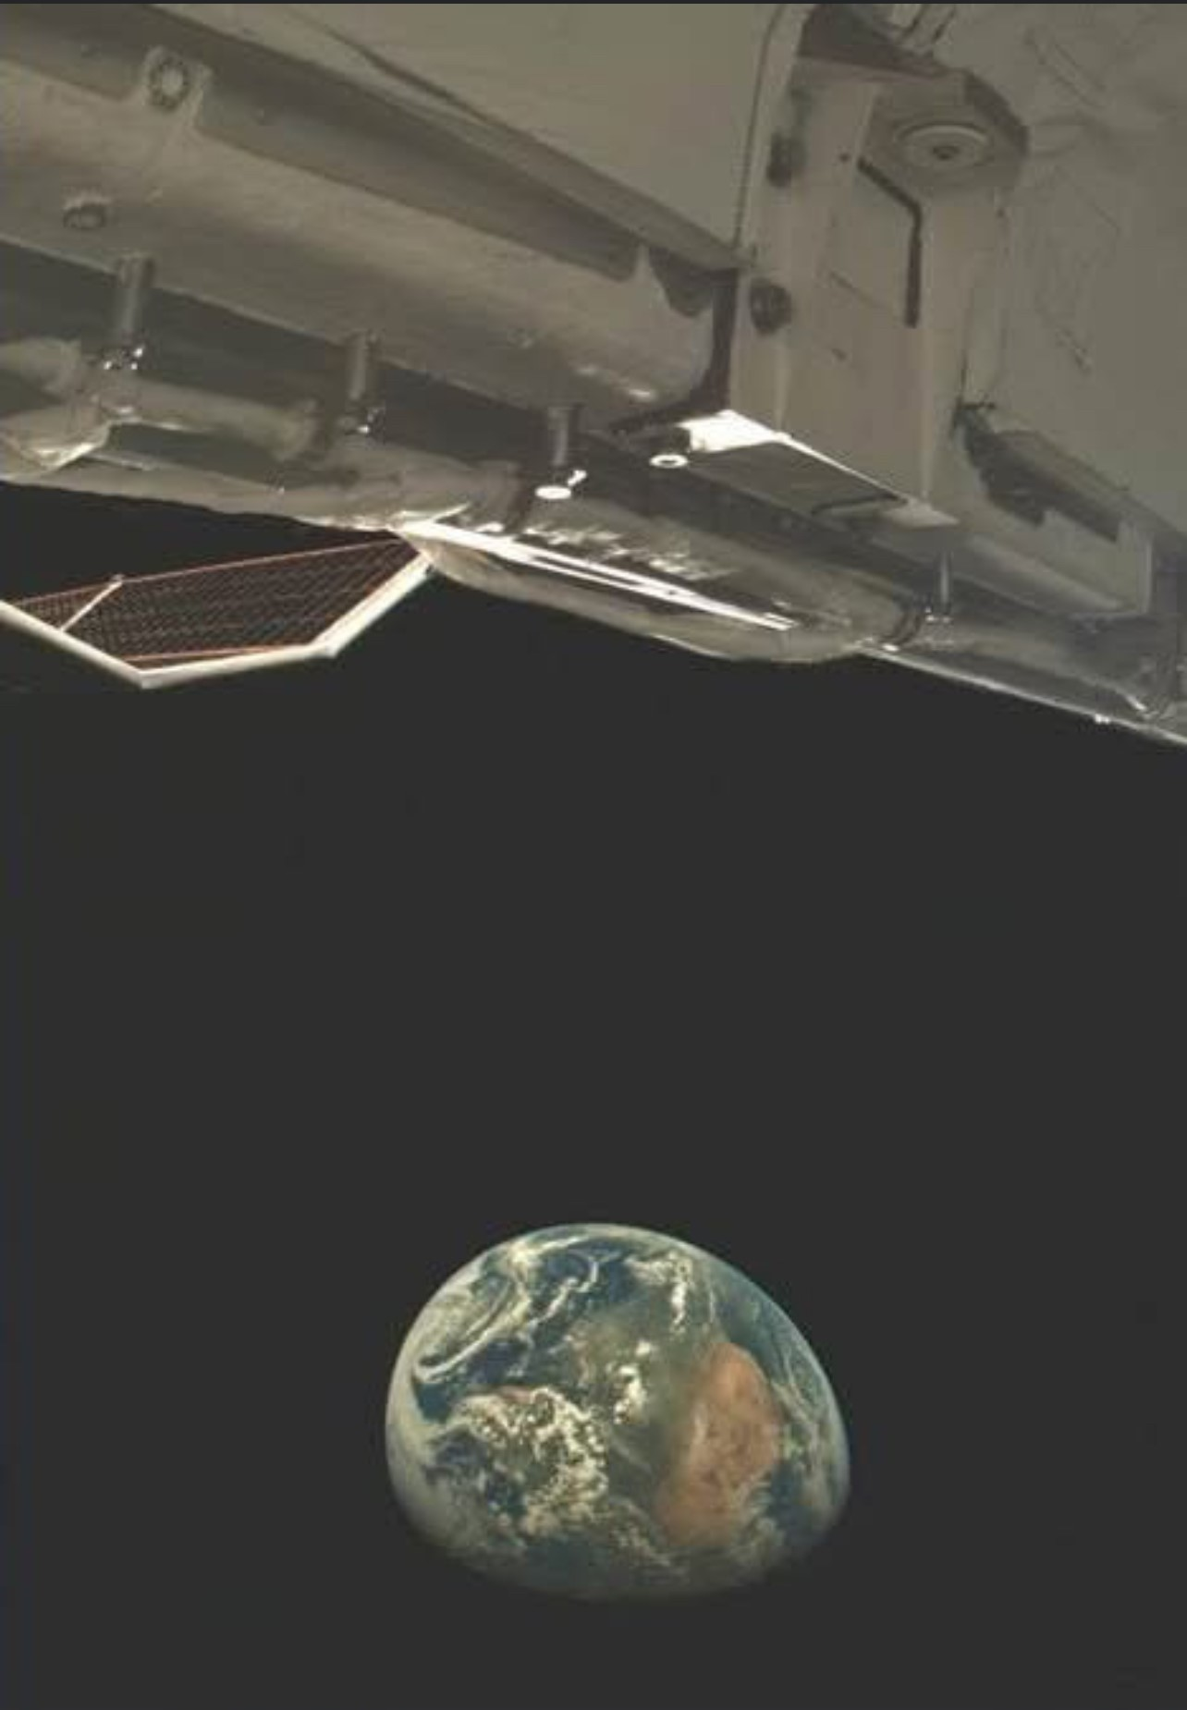

Slide 2
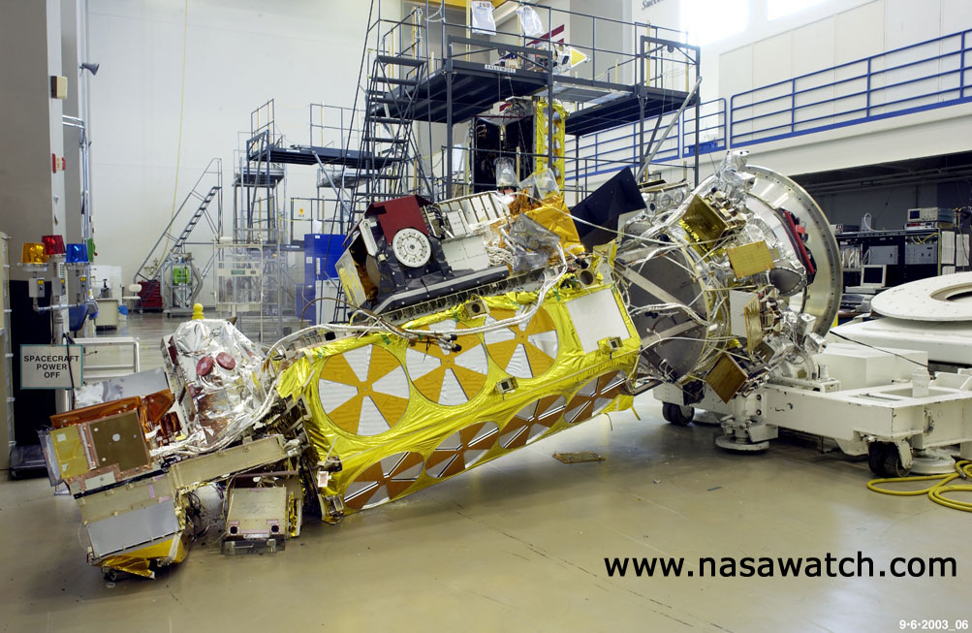
Attitude System

Slide 3
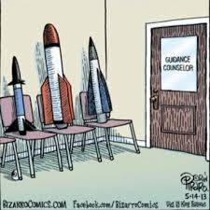

Slide 4
Attitude
Requirements which depend on the mission:
point radiators to space
point solar array to sun
point sensor to target
point antenna to ground station
minimum drag
Steerable vs. non-steerable

Slide 5
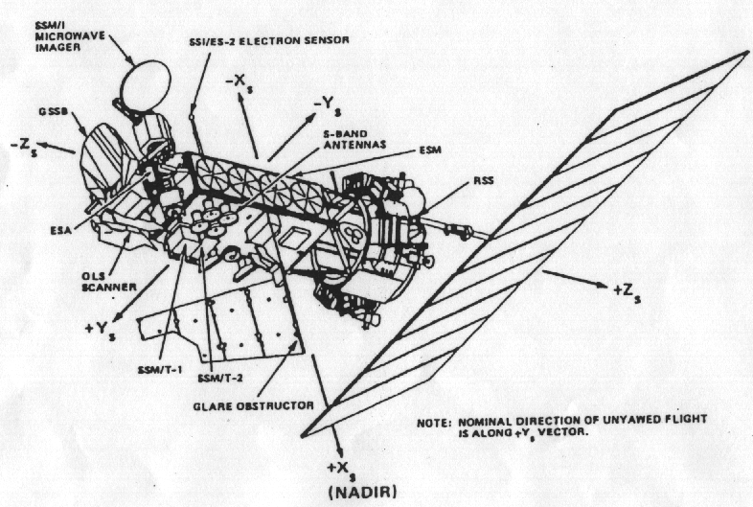
Attitude

Slide 6
Control Loops

Slide 7
Attitude Control
Combat external forces - Disturbance Torques
Reaction wheels
Torque – rotational linear force
Momentum – force that keeps an object moving
Torque Rods – Electromagnetics
Thrusters
Exotics
Gravity gradient

Slide 8
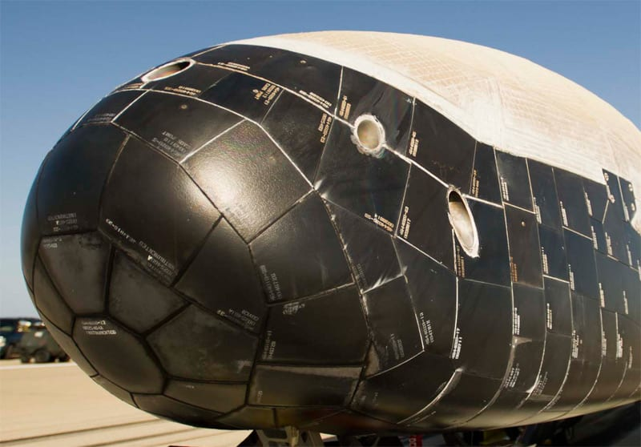
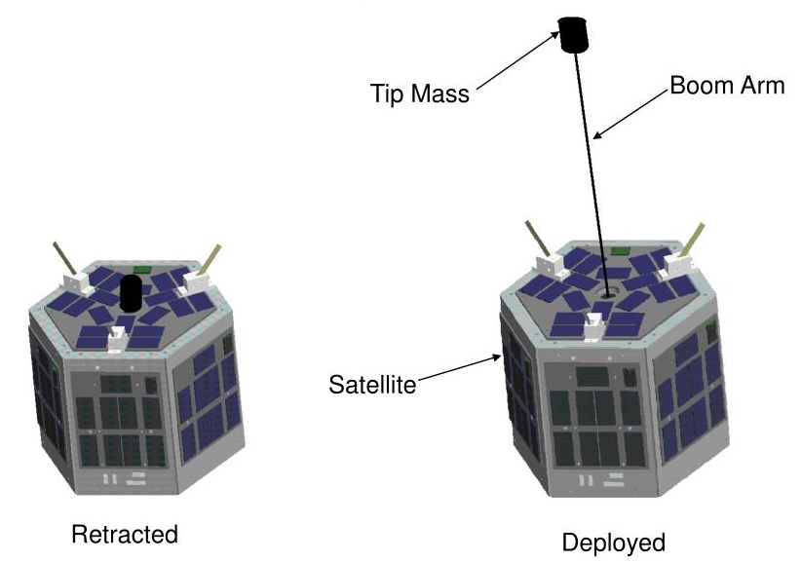
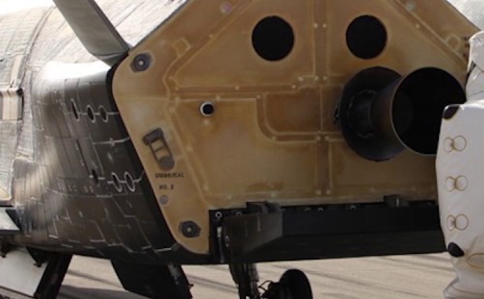
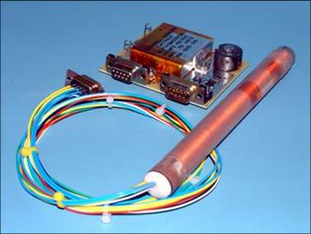
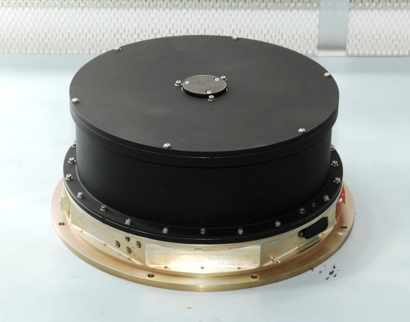

Slide 9
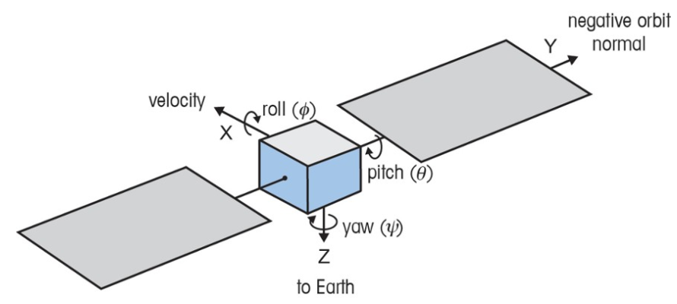
Vehicle Coordinates

Slide 10
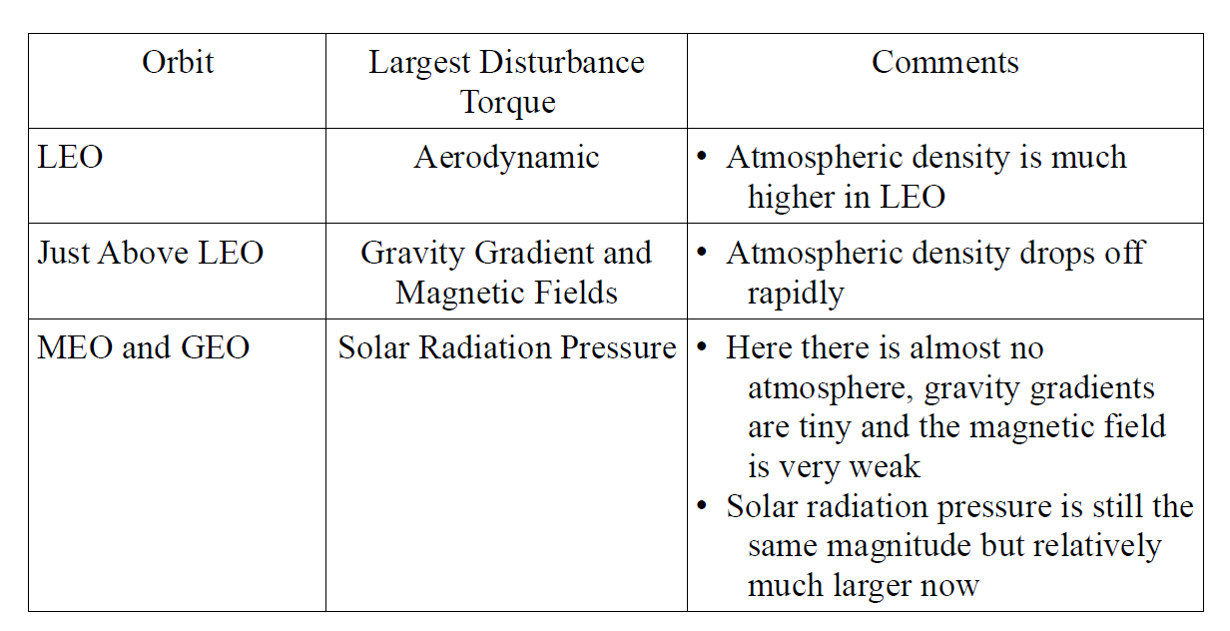
Orbits & Disturbance Torques

Slide 11
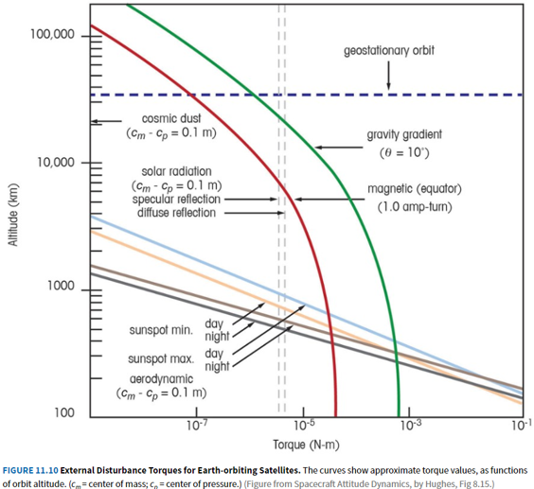
Torque
For a 3-axis stabilized spacecraft, attitude authority (torque) must be greater than disturbance torques

Slide 12
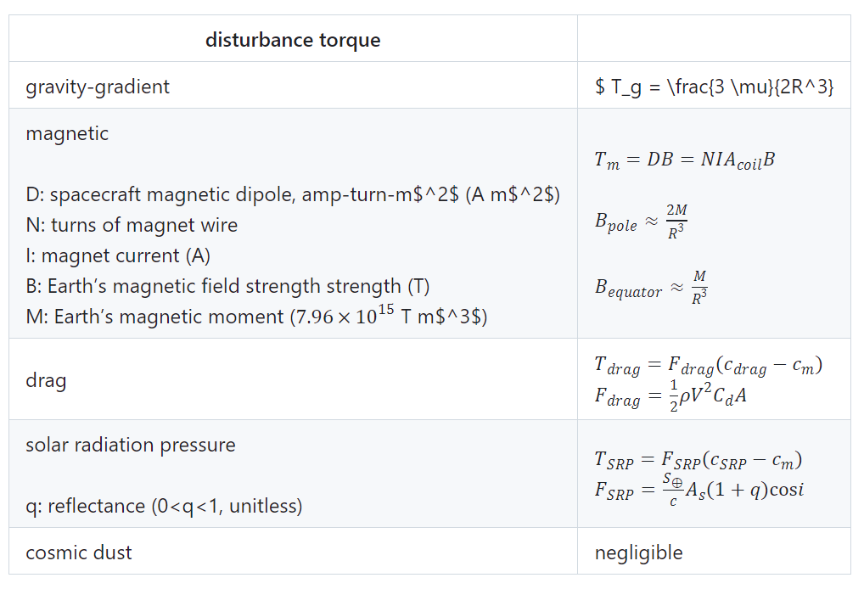

$$T_{g}=\left(\frac{3μ}{2R^{3}}\right)$$

Slide 13

Countering Disturbances

Slide 14
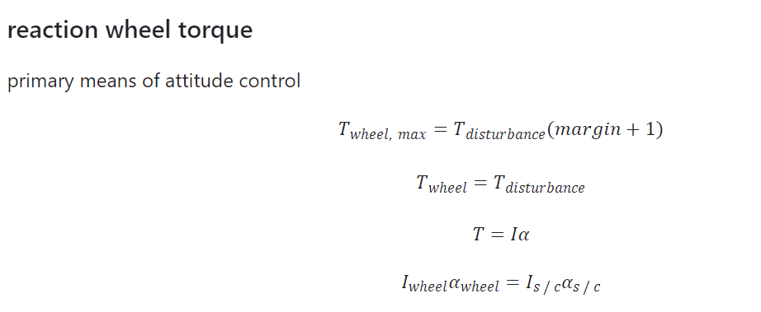
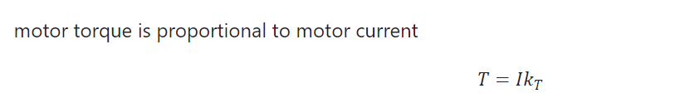
Reaction Wheels

Slide 15
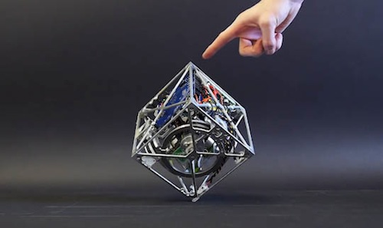
Reaction Wheels
Notes:
Kepler

Slide 16
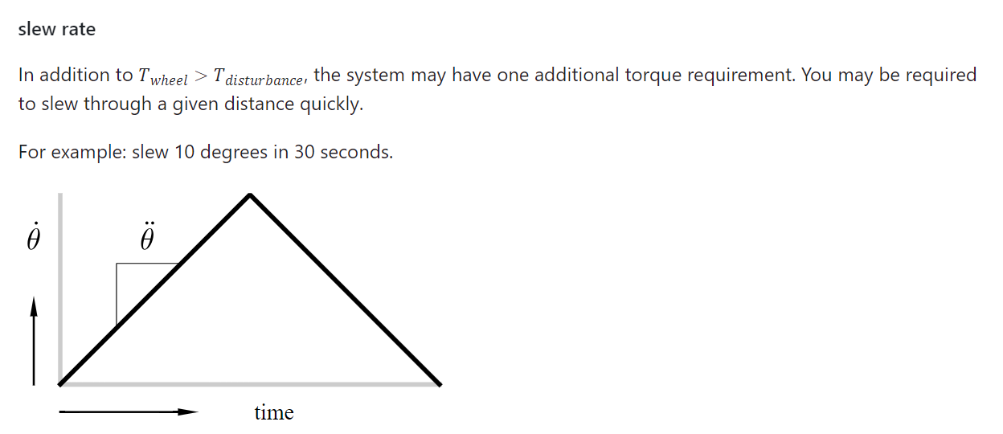
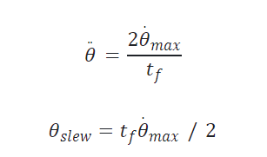
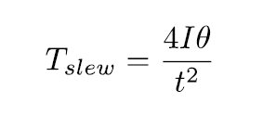

Slew

Slide 17
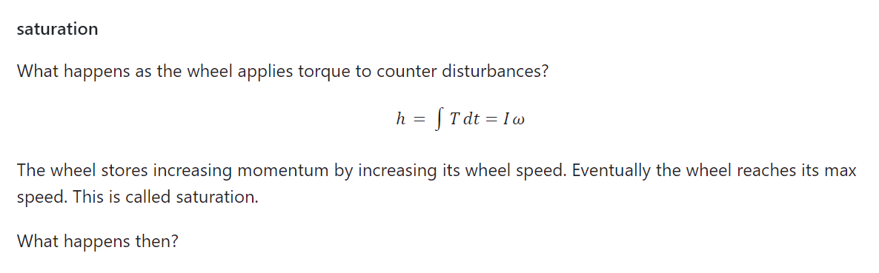
Saturation

Slide 18
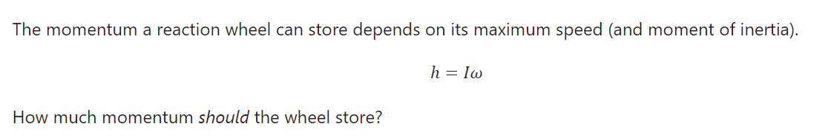
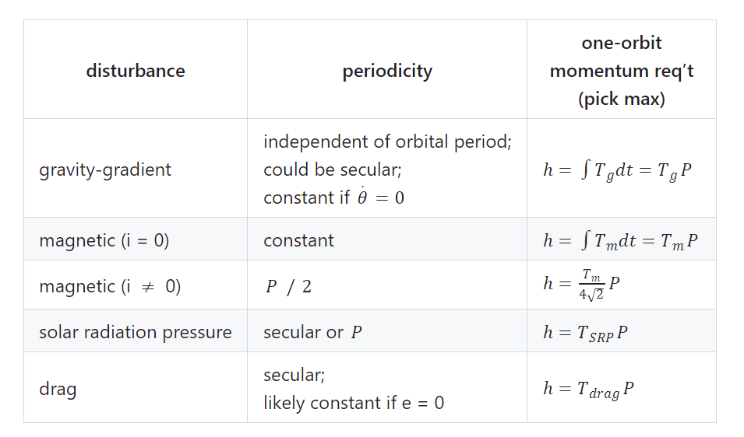
Momentum
Ignoring cost or mass concerns, more momentum storage is better. Over a longer time period, it is possible that disturbances will partially cancel each other.
Notes:
3-axis, 3 wheels, 4th for redundancy

Slide 19
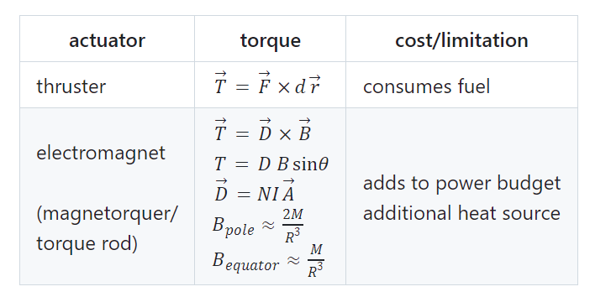
Desaturation
When the wheel reaches its maximum speed, it is said to be saturated and can no longer counter disturbance torques.
To maintain control of the spacecraft, the spacecraft needs to perform momentum dumping—using an external actuator to reject momentum from the system. There are two common external attitude actuators that work in space.

Slide 20
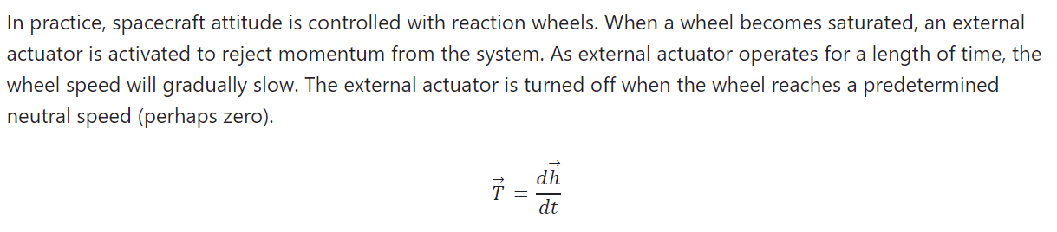
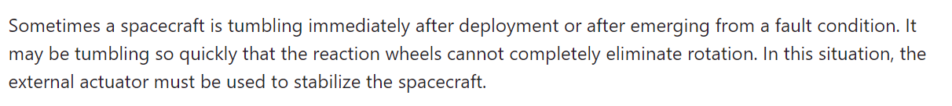
Desaturation

Slide 21
Attitude Sensors
Sensor | Approx accuracy limit | Comments
Magnetometer | 1 deg | 2-axis knowledge required to control torque rods
Sun | 0.5 deg | 2-axis knowledge Sun direction
Earth | 0.1 deg | Earth Limb 2-axis knowledge
Star | 0.001 deg | 3-axis knowledge
Inertial Measurement Unit | 0.05 deg | Requires re-cal Set of gyros and accelerometers
Ring Laser Gyroscope | 0.05 deg | 3-axis drifts Laser in a loop Drifts over time

Slide 22
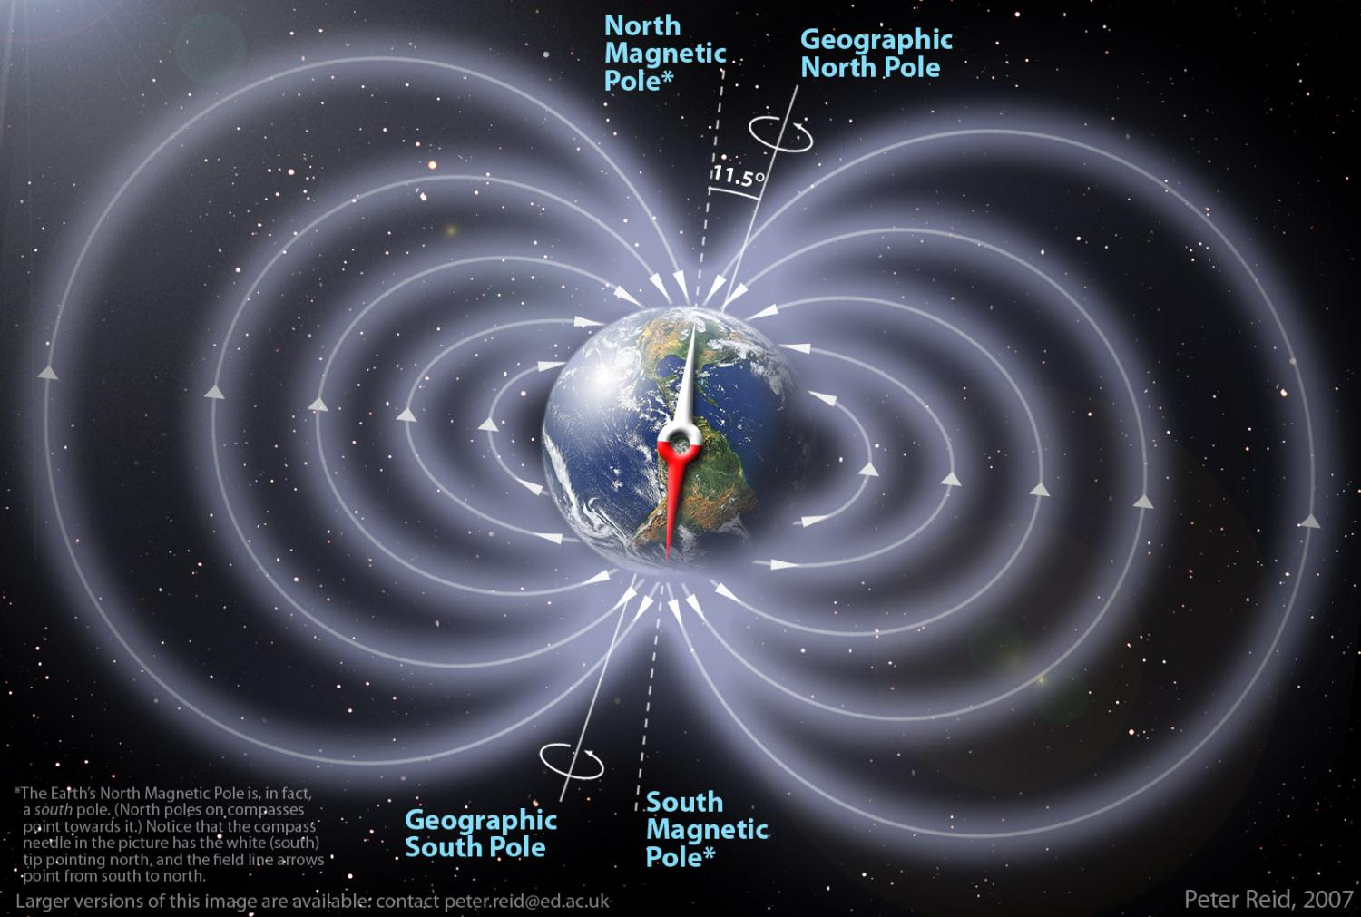
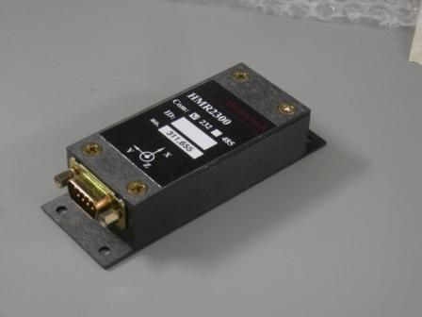
Magnetometer

Slide 23
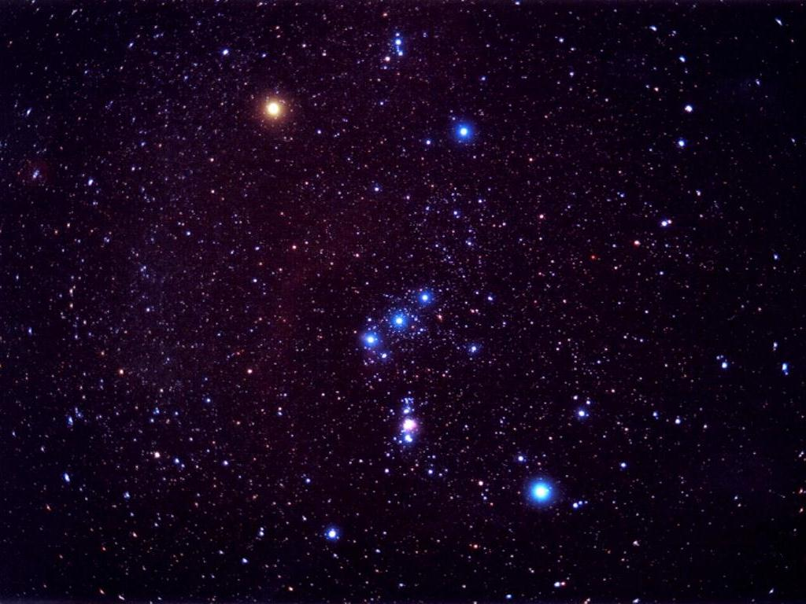
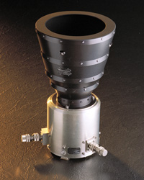
Star Tracker

Slide 24
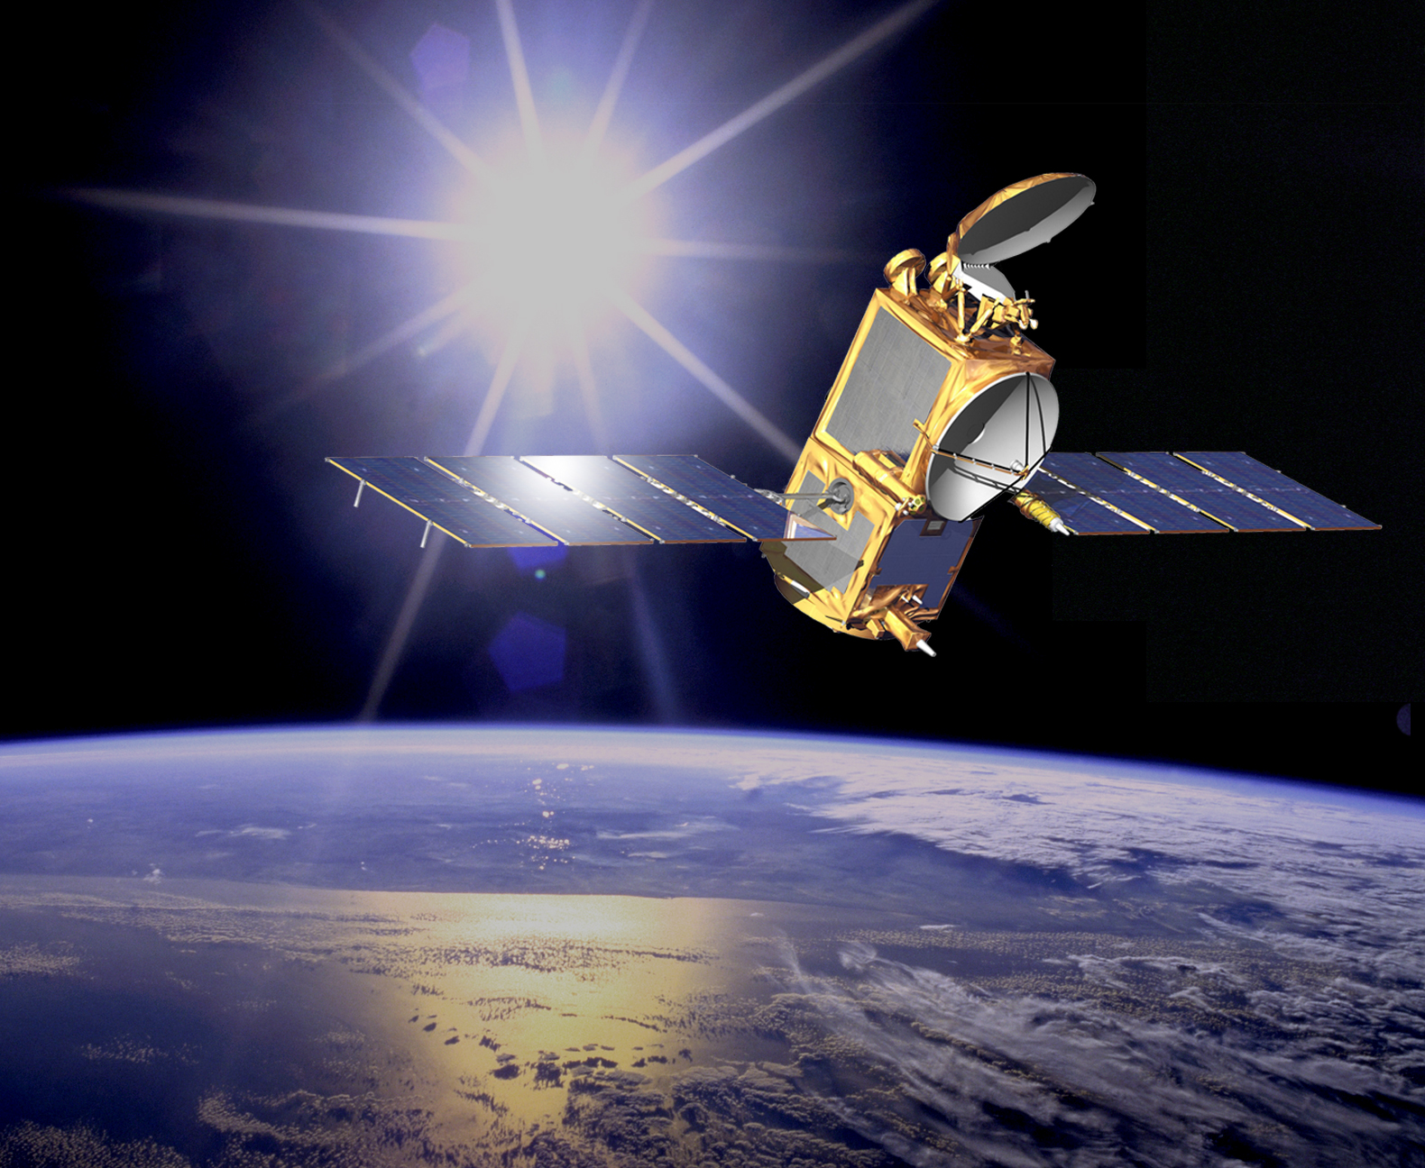
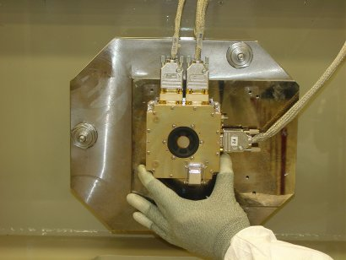
Sun Sensor

Slide 25
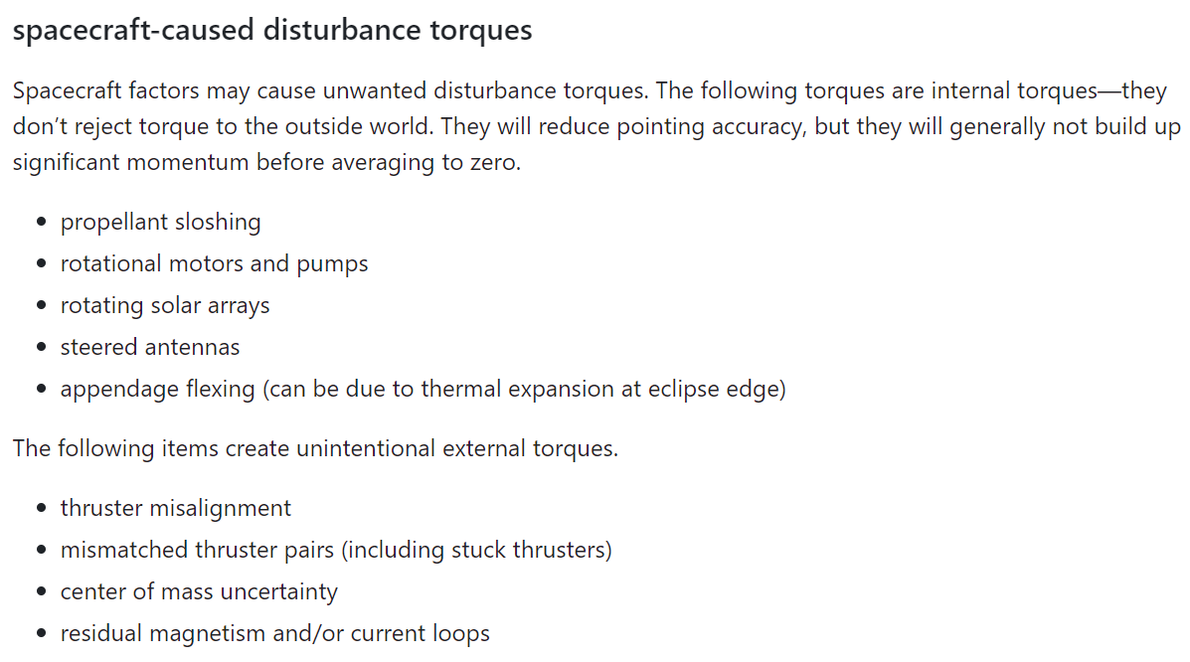
S/C caused disturbance torques

Slide 26
Summary
reaction wheel sizing
torque > disturbance torques
torque meets any slew rate requirement
wheel stores sufficient momentum (at least one orbit’s worth)
external actuator sizing
torque > disturbance torques (generally a trivial requirement)

